Slide 1

Programming Paper Planes
C-Tech²: Computers and Technology at Virginia Tech
June 26-29, 2018
155 Goodwin Hall

Slide 2
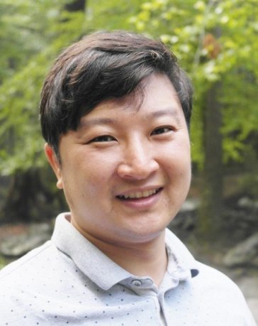


Team Members
Dr. Dongyoon Lee
Assistant Professor in Computer Science Dept.
dongyoon@vt.edu
Casey Haney
Freshman in Engineering
caseyh4@vt.edu
Xinwei Fu
Ph.D. student in Computer Science Dept.
fuxinwei@vt.edu

Slide 3
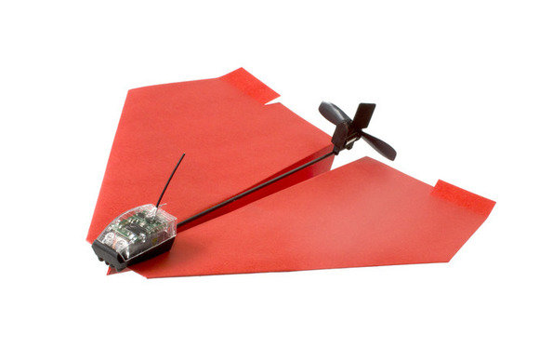



The PowerUp Paper Plane
1) Propeller: Speed UP/DOWN
Paper Plane
2) Rudder: Turn LEFT/RIGHT
Keyboard

Slide 4
Demo

Slide 5
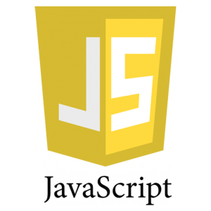
What is JavaScript?
A programming language that computers understand so they can follow instructions
Widely used to program dynamic web pages
e.g., Facebook, Gmail, etc.

Slide 6





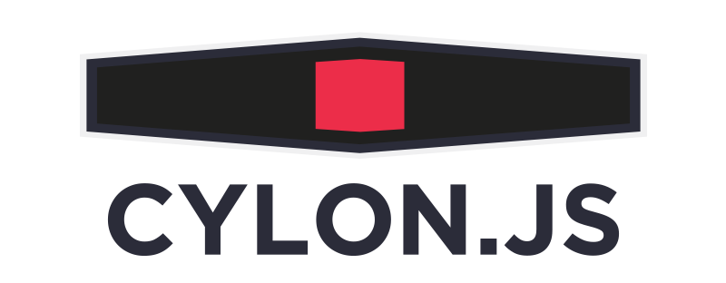
Node.js: A Server-side JavaScript
Allows programmers to use JavaScript to build a web server
Can be used to control a robot

Slide 7
Using Node.js to Make a Paper Plane Fly
1) Propeller
2) Rudder
Keyboard Events:
Up, Down, Left, and Right

Slide 8
Programming Basics

Slide 9
Variables
Variables – Just like in math, variables are symbolic representations of things that may change as time goes on
X = 3 is an example of a programming variable
Y = X – 2 would create a new variable that will set Y = 1
Variables can also be true or false (Boolean)

Slide 10
Functions
Functions in code are very similar to functions in math
Typically, they take one or more inputs (parameters) and return some output
Functions are helpful to create when you wish to use them in multiple different programs, as they can be saved as a new file and reused at any time

Slide 11
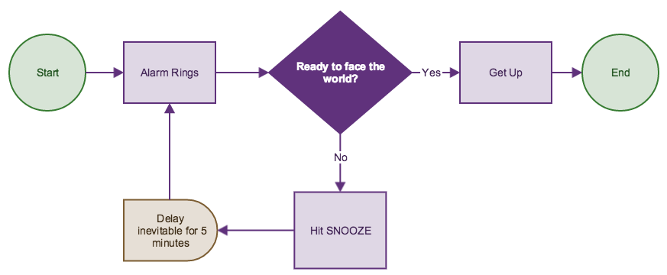
Flow Control
Sometimes, code has different paths it can take based on certain conditions
To determine where the code will go, true/false statements are used, where true will send you one direction and false will send you another
This is also how flow charts are made!

Slide 12
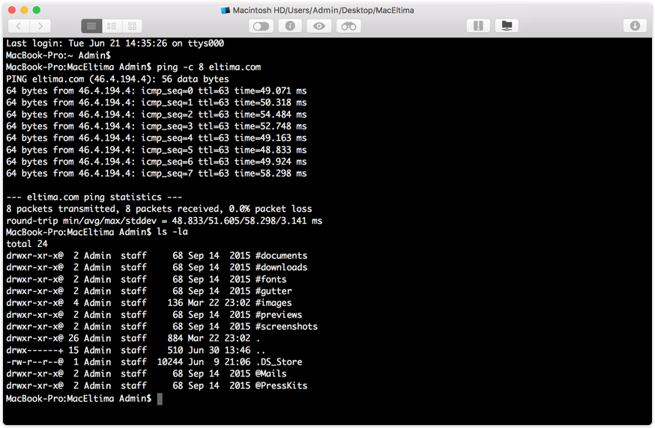
Console.log()
Console.log() is a method to display information on the interface (screen) that you’re using
Any text or variables you wish to display on the screen go in the parenthesis, separated by commas

Slide 13
You Try It – What Does the Code Do?
1)
var square = function(number) {
return number * number;
}
var x = square(4);
console.log(x);
2)
var ready = false
if (ready) {
console.log(ready);
}
else if (!ready) {
ready = true;
}

Slide 14
Callback Functions
Special type of function that acts as a loop for the code
Takes two inputs and returns two outputs
The first parameter is an error placeholder – an empty seat where an error will go if there’s a problem with the code
The second is the data that the callback will take back to start of the function and run it again
This continues until the condition is met

Slide 15
The Best Way to Learn is to Try it!
On your computers, open the File Navigator, and go to Downloads > PowerUpCylon-template > app.js
This is the (mostly) empty template we will use to program the plane to control its flight!

